Slide 1
The Work-Life Balance Formula: “Identifying Top 5 Drivers of Work-Life Balance”
A Non-Technical Presentation
By Phaedra Wells

Slide 2
Identifying the top 5 factors that most significantly influence work-life balance would allow organizations to develop initiatives that could help its members achieve a healthy work-life balance, resulting in increased productivity and a positive impact on organizational success over the short and long term. _________________________________________________________________________
Background information to consider:
Overworking has become a cultural norm of the most recent decades.
While working more may be have positive effects professionally, overworking also has negative effects mentally and physically.
Burned-out and unhealthy organizational members are not able to maximize their productivity.
Organizational productivity has been linked to the work-life balance of its members.
Sources: 79 WORK-LIFE BALANCE STATISTICS: 2020/2021 CURRENT STATE & INDUSTRY PRACTICES

Slide 3
Executive Summary Using a work-life balance survey, a visual and statistical investigation of the respondents and the relationship between work-life balance scores and variables within the survey resulted in the successful identification of the top variables that influence work-life balance.
Things to Explore | Insights
How do respondents typically score on the work-life balance survey? | Most of the respondents scored in the middle of the work-balance score range.
How do uncontrollable factors within the survey affect the work-life balance score? | The uncontrollable factors of the survey were found to have extremely little to no affect on the work-life balance scores.
What is the relationship between the other variables in the survey and the work-life balance score? | Some variables influenced the work-life balance score positively and some negatively, but some variables were successfully identified as the top 5 drivers of work-life balance.
How influential are these variables that are most closely related to the work-life balance score? | The variables that were found to have the strongest relationships with work-life balance have a very significant relationship to the score.
How can organizations use this information? | Organizations can use the top 5 drivers of the work-life balance score to help its members improve their work-life balance.
Sources: Lifestyle_and_Wellbeing_Data | Kaggle

Slide 4
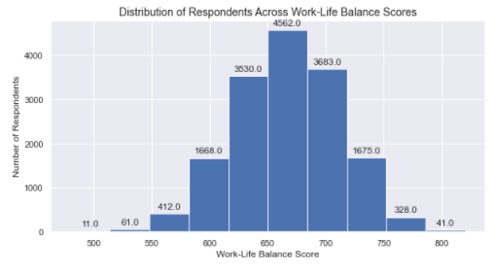
Most of the respondents scored in the middle of the work-balance score range.
Key Insights: Most respondents scored between 620-720 and nearly an equal number of respondents scored above and below these scores. This visualization suggests that most respondents who take this survey will have a work-life balance score between 620 and 720.
Sources: Lifestyle_and_Wellbeing_Data | Kaggle

Slide 5
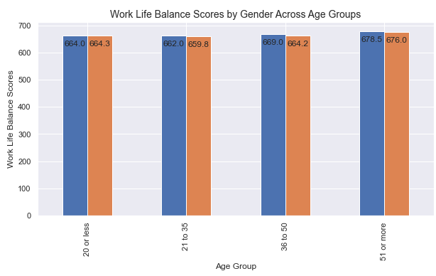
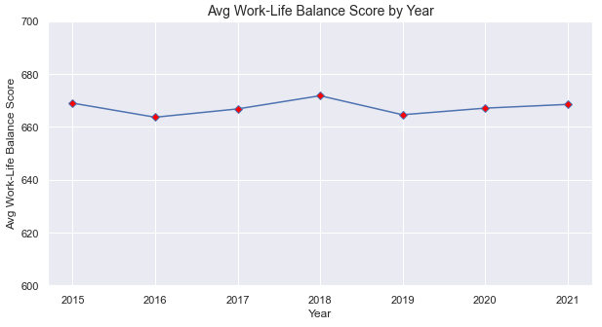
Work-life balance does not depend heavily on the uncontrollable factors of the survey.
Key Insights: Using visualization methodologies uncovers that age, gender, or time do not significantly influence work-life balance. Without considering any other external factors, this finding may suggest that work-life balance is primarily based upon factors that the individual can control.
Sources: Lifestyle_and_Wellbeing_Data | Kaggle

Slide 6
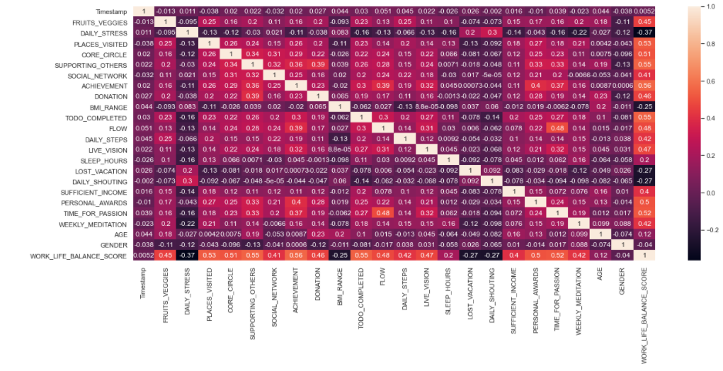
The Top 5 Drivers of Work-Life Balance have been identified as Achievement, Support to Others, Productivity, Number of Places Visited, and Time for Passion.
Key Insights: Notice that there are some variables that negatively influence work-life balance score, however, they are not as strongly related to the overall score.
Sources: Lifestyle_and_Wellbeing_Data | Kaggle

Slide 7
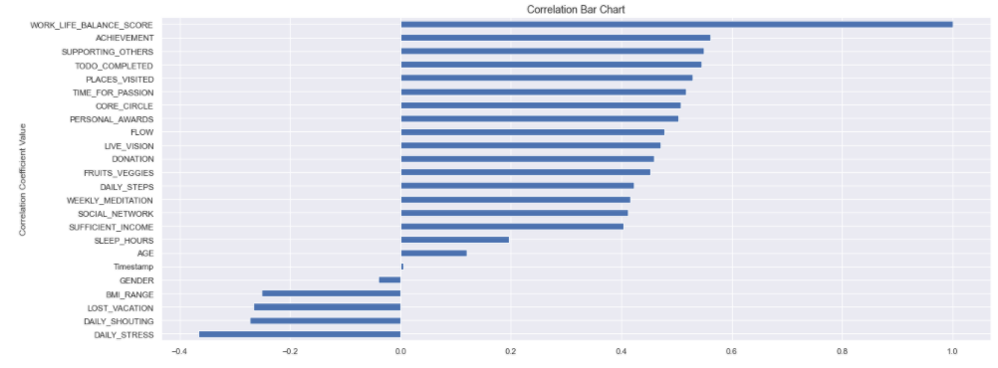
The variables that have the most influence on the work-life balance score are significantly influential.
Key Insights: Eliminating the factors that are not as closely linked to the work-life balance score (variables with a relationship between -0.4 and 0.4) enabled the creation of a statistical equation which indicates that it is very unlikely that the work-life balance scores are a result of chance and the probability of predicting work-life balance scores based on the variables that are the most closely linked to work-life balance is strong.
Sources: Lifestyle_and_Wellbeing_Data | Kaggle

Slide 8
Having used visual and high-level analysis to identify
Achievement
Support to Others
Productivity
Number of Places Visited
Time for Passion
as Top 5 Drivers of Work-Life Balance, organizational leaders may be able to positively influence productivity by creating opportunities that can help organizational members improve their work-life balance.
Key Insights :
“…85% of businesses that provide work life balance opportunities report that they are more productive.”
“A Stanford University study showed that work life balance programs, such as remote working, could lead to a 13% performance increase.”
“Around 21% of workers with good work life balance tend to work harder.”
Top Work-Life Balance Factor | Initiative Example
Achievement | Implement initiative for leaders to help organizational members set and reach attainable monthly goals
Support to Others | Develop a co-worker mentorship program
Productivity | Allow flexible work schedules to help employees increase professional and personal productivity
Number of Places Visited | Host meetings or sponsor events at different local venues
Time for Passion | Create passion within the organization by helping individuals see how their part is important to the “bigger picture” to develop a sense of purpose
Sources: 79 WORK-LIFE BALANCE STATISTICS: 2020/2021 CURRENT STATE & INDUSTRY PRACTICES
Lifestyle_and_Wellbeing_Data | Kaggle

